Slide 1
Low-Light Image Enhancement
By
Shiv Kumar Ganesh
Kumuda B G Murthy
Raghava D Urs
Arun Talkad

Slide 2
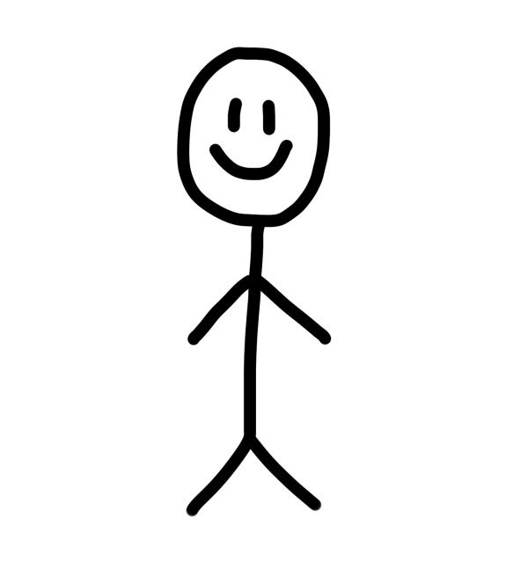
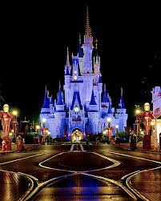
Goal
I wish I could enhance the quality of this old picture.
There could be multiple instances where we end up taking pictures in low or bad lighting. We would love to have these images enhanced to have better contrast and visibility.
This research introduces a new method called Zero-Reference Low Light Enhancement, which treats light enhancement as a deep network task of image-specific curve estimation.
Our method uses DCE-Net, a lightweight deep network, to predict pixel-wise and high-order curves for image dynamic range modification. Zero-DCE is intriguing because it makes no assumptions about reference images during training, i.e. it doesn't require any paired or unpaired data.
Model
Notes:
This is accomplished via a series of properly constructed non-reference loss functions that implicitly quantify the network's enhancement quality and drive its learning. Extensive tests on a variety of benchmarks show that our technology outperforms state-of-the-art methods both qualitatively and numerically. Also presented are the possible benefits of our Zero-DCE for face detection in the dark.

Slide 3
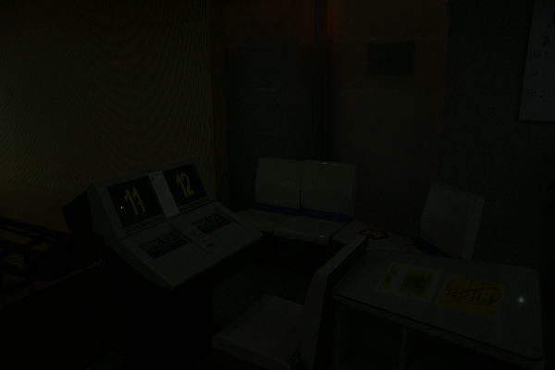
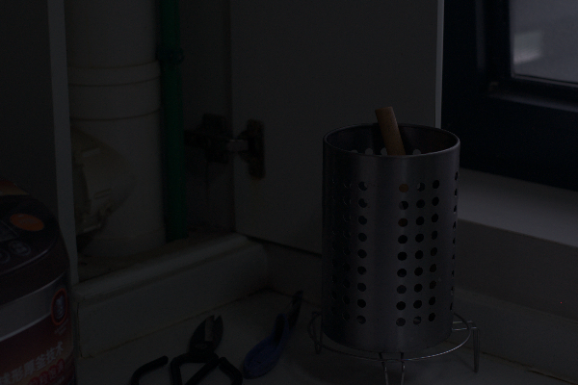
Data Collection
Source : LOL Dataset
Data Size : 485 images Data Format : PNG images
Original Image
Notes:
We use 300 low-light images from the LoL Dataset training set for training, and we use the remaining 185 low-light images for validation. We resize the images to size 256 x 256 to be used for both training and validation. Note that in order to train the DCE-Net, we will not require the corresponding enhanced images.

Slide 4
Image Pre-processing
High quality images were considered for this experiment.
Images were pre-processed to reduce the resolution to 256 X 256 pixel.
Color information and the color curves for each individual image were extracted in order to feed Zero-DCE model.
Deep curve estimation was done in each image. This helped to extract the low light RBG information that was fed further to enlighten GAN.
Notes:
The images from the LOL dataset are preprocessed before using them in the training and validation phases. The data preprocessing involves three steps: decomposition, downscaling and normalization.
Decoding: The PNG image data is in the form of a compressed string. The PNG data is decoded into 8-bit integer tensors to make computation easier.
Downscaling: Downscaling is the reduction of the image to a specific resolution. Neural networks require inputs of the same size and the training process is made faster by downscaling the images to a pre-determined size. The images have a resolution of 400 by 600 pixels, it is reduced to 256 by 256 in this study.
Normalization: Neural Nets reach convergence more quickly if the data is normalized. In the study, all the image data is divided by 255 to ensure that they are in the range [0,1].
The operations are carried out using the TensorFlow data pipeline which allows for batch operations to be performed.

Slide 5
Zero-DCE
The goal of DCE-Net is to estimate a set of best-fitting light-enhancement curves (LE-curves) given an input image.
The framework then maps all pixels of the input’s RGB channels by applying the curves iteratively to obtain the final enhanced image.
Color information and the color curves for each individual image were extracted in order to feed Zero-DCE model.
Deep curve estimation was done in each image. This helped to extract the low light RBG information that was fed further to enlighten GAN.

Slide 6
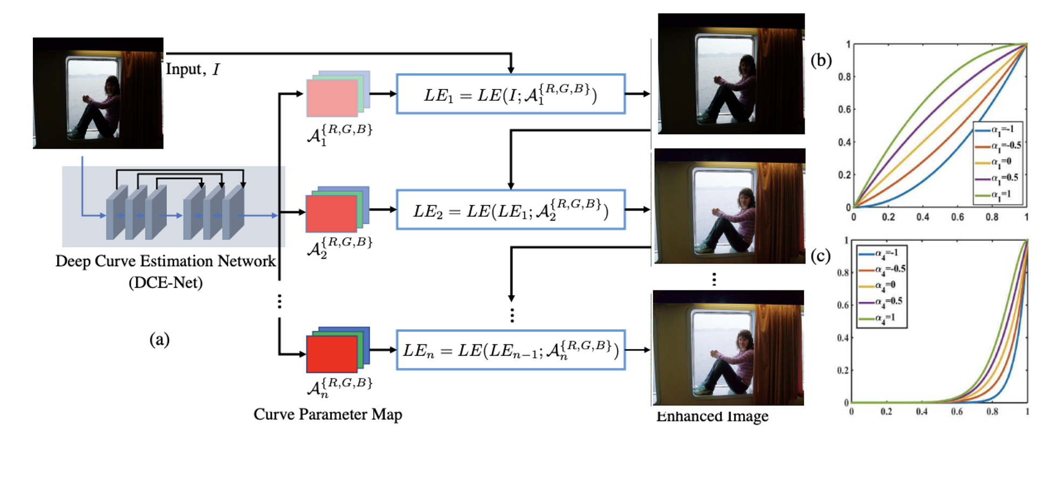
Model Architecture

Slide 7
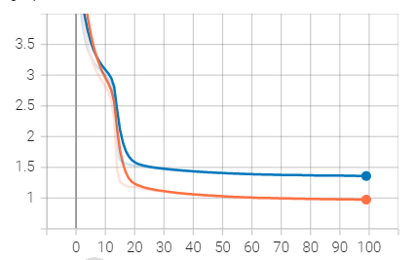
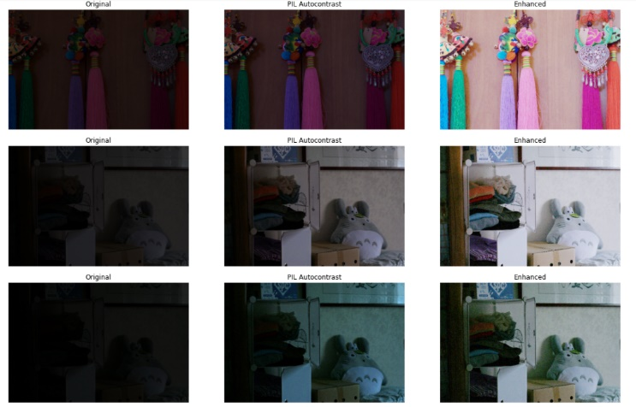
Training and Validation
Training and Validation Loss
After hyper parameter tuning, neural network of 8 convolutional layers was considered for prediction.
The first five convolutional layers have ReLU activation function, and the last convolutional layer has tanh.
The training set is fed to the model built above for around 100 epochs with a learning rate of 1e-4
Original vs Baseline vs Model

Slide 8
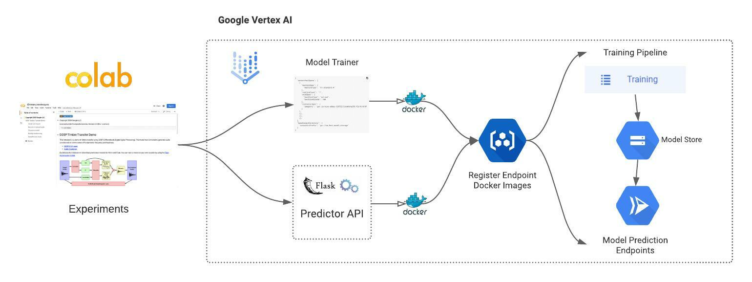
MLOps Architecture

Slide 9

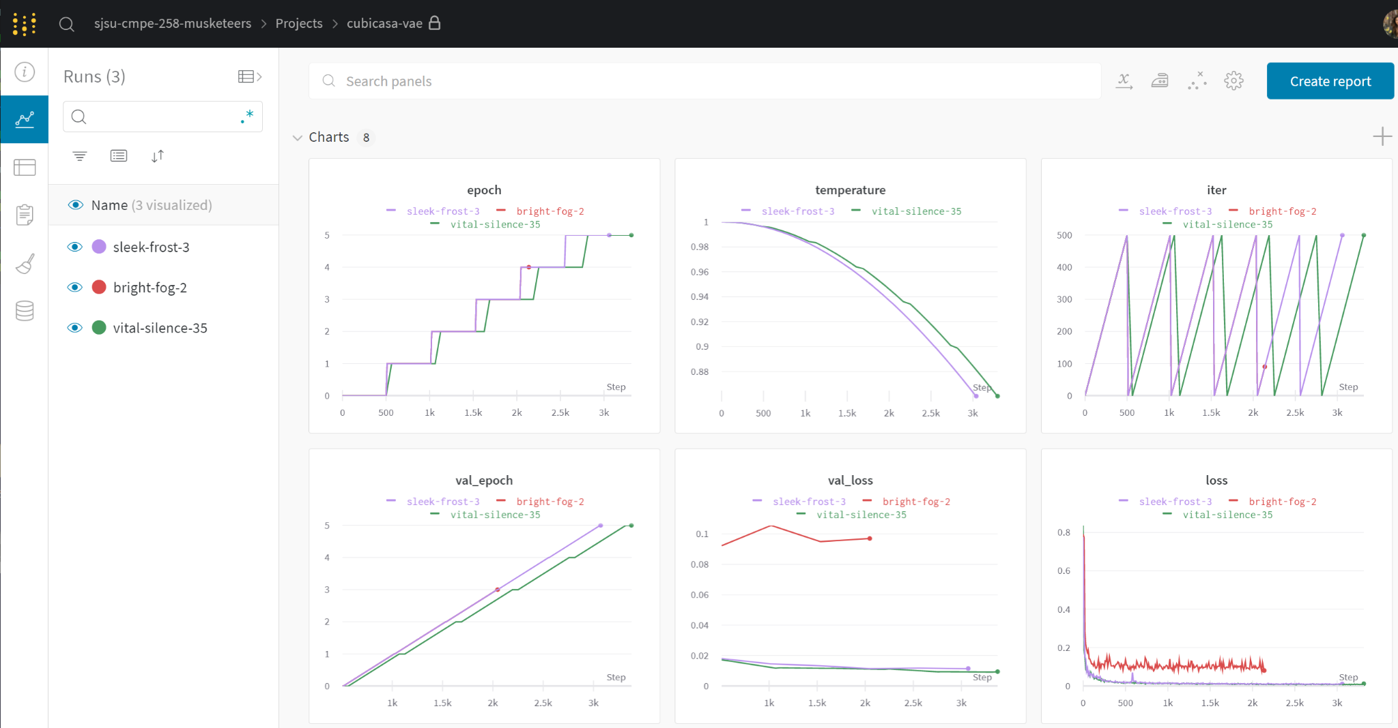
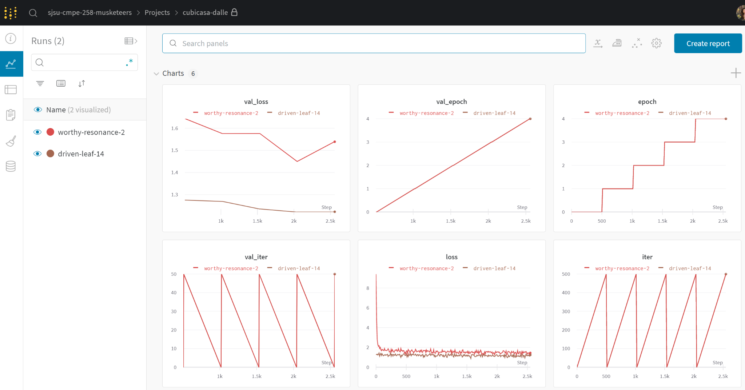
MLOps - WandB
Zero-DCE Pipeline Runs
Notes:
Used W&B for visualizing the experiments

Slide 10
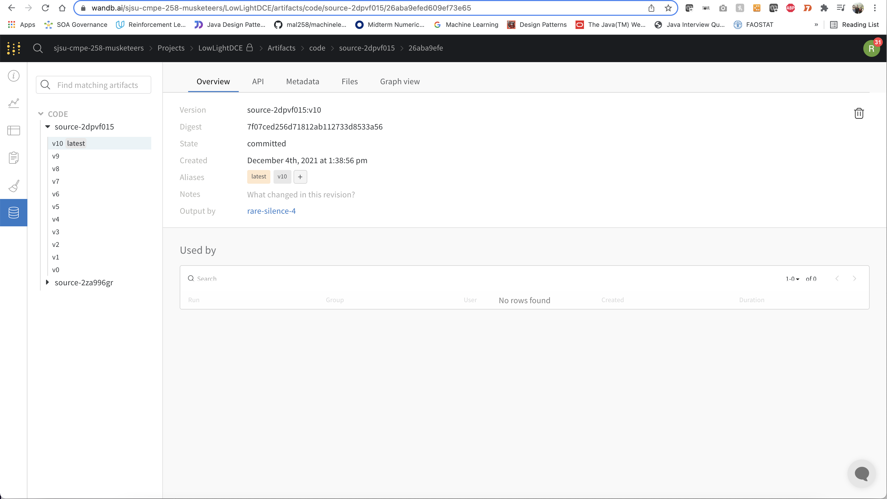
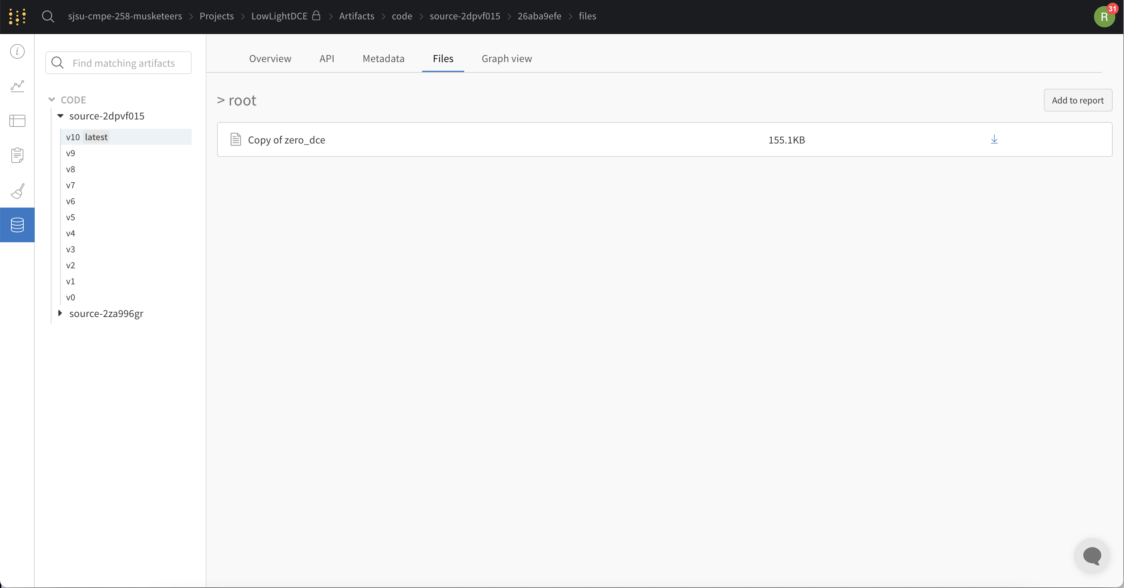
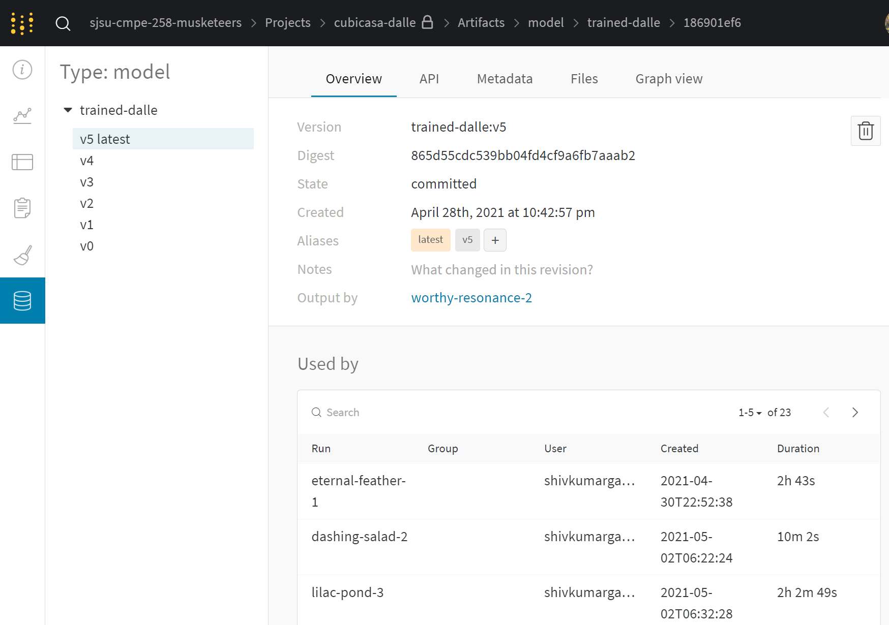
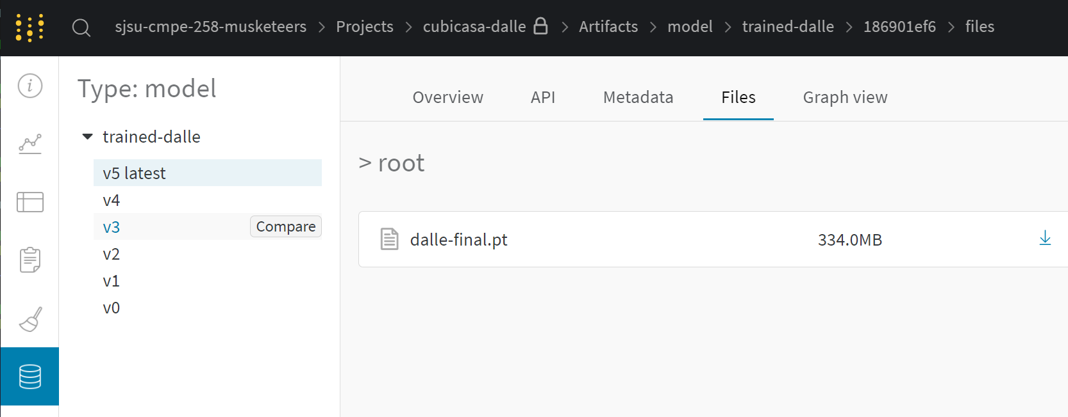
MLOps - WandB
Model Tracking/Logging
Model Versioning/Repository

Slide 11
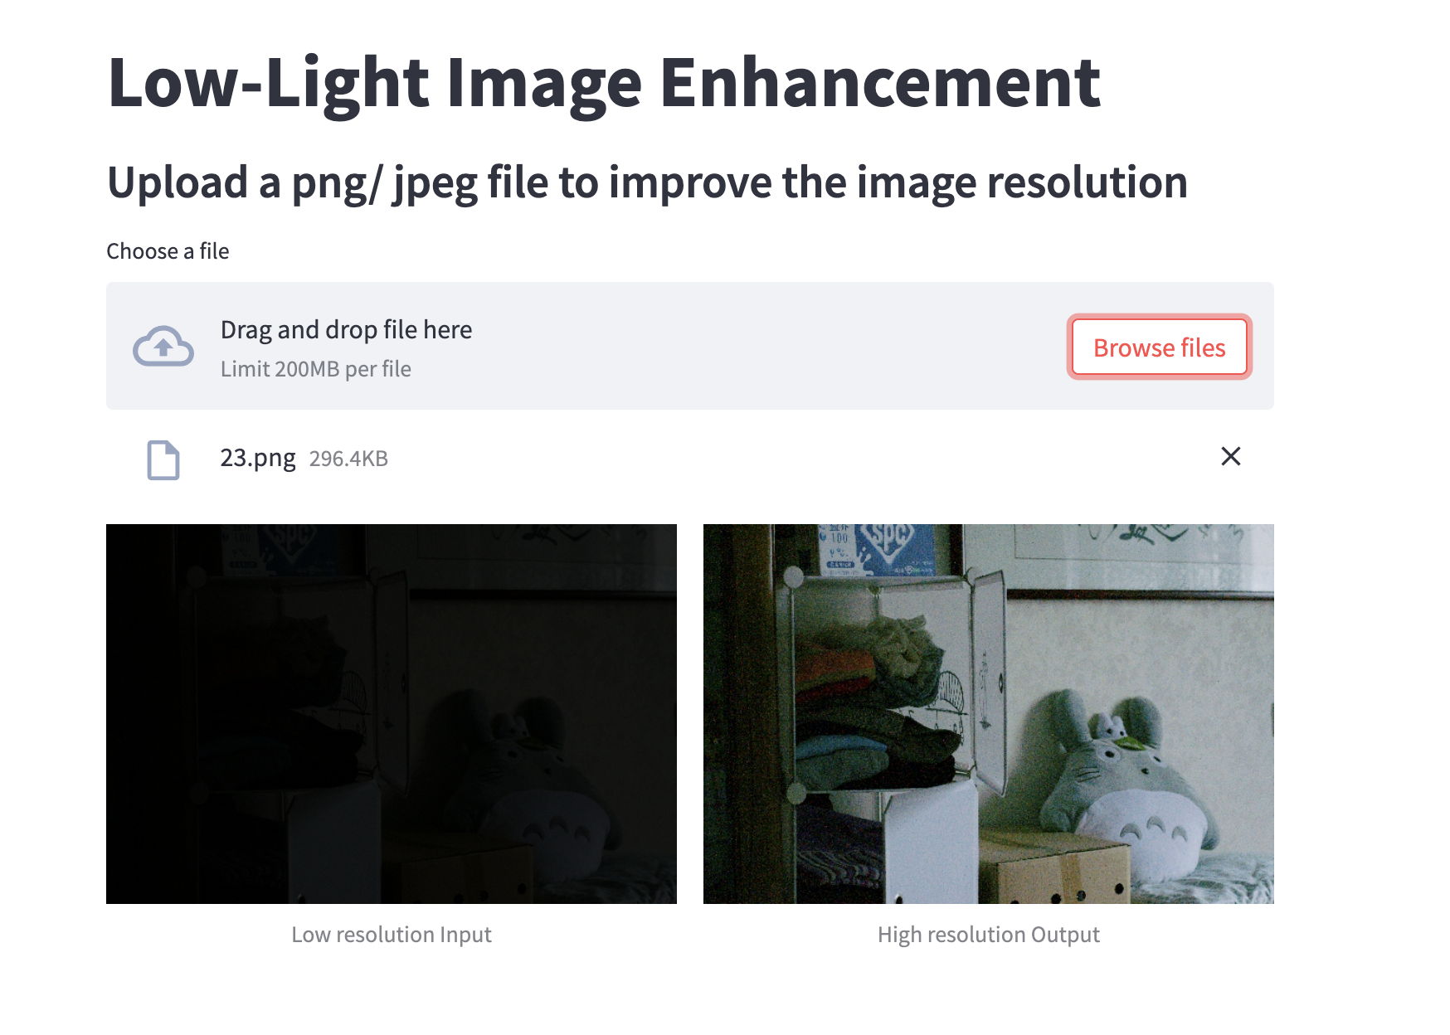
Demo in Streamlit
The inference can be viewed on providing low light image and get improved image as a result.
Application URL: https://share.streamlit.io/raghavadevarajeurs/low-light-image-enhancement/main/inference.py

Slide 12
Technical Difficulty
Finding appropriate problem scope
changed our dataset from original larger scope
restricted type of images to smaller size images
Understanding of domain which dealt with image manipulation and Image related algorithms.
RAM/memory usage
paying for Colab Pro helped

Slide 13
Lesson Learnt
Generative tasks require a lot of data and computing resources
We needed to keep our scope small for what type of images to generate

Slide 14
Teamwork
Slack was used as the medium of communication across the team.
We followed agile methodology for project management and its execution. We met as a team every Wednesday at 8PM.
The version control system used was git and the project was pushed to GitHub to be stored.
Team communication played an important role in development of the project.

Slide 15
Code and Version Control
Packages : Tensorflow, matplotlib, WandB, PIL, Streamlit
Input : High resolution low light images
Output : High resolution good contrast images
DL Model : Zero-DCE
Tools Used : Google Colab Pro, Weights and Biases (WandB) Google Colab : Low Light Image Enhancement Version Ctrl : GitHub MLOps : Vertex AI

Slide 16
Thank You

